Slide 1
DPM: A novel distributed large-scale social graph processing framework for link prediction algorithms
DPM:一个用于链接预测算法的新型分布式大型社交图处理框架
2018.3.26

Slide 2
1. Abstract
背景
  Recommendation algorithms for graphs, particularly link prediction algorithms, have different requirements depending of the way the underlying graph is traversed. Path-based algorithms usually perform traversals in different directions to build a large ranking of vertices to recommend, whereas random walk-based algorithms build an initial subgraph and perform several iterations on those vertices to compute the final ranking.
  图的推荐算法，特别是链接预测算法，根据图的遍历方式，有不同的需求。基于路径的算法通常在不同的方向上执行遍历，以建立顶点次序来推荐；而基于随机游走的算法构建一个初始子图并在这些顶点上执行多次迭代来计算最终的排名。

Slide 3
1. Abstract
DPM
  In this work, we propose a distributed graph processing framework called Distributed Partitioned Merge (DPM), which supports both types of algorithms and we compare its performance and resource usage w.r.t. two relevant frameworks, namely Fork-Join and Pregel.
  在此工作中，我们提出一个分布式的图形处理框架，称为分布式分区合并（DPM），它支持两种算法，并将其性能和资源消耗与两个相关的框架进行比较，Fork-Join和Pregel。

Slide 4
1. Abstract
实验对比
  In our experiments, we show that in most tests DPM outperforms both Pregel and Fork-Join in terms of recommendation time, with a minor penalization in network usage in some scenarios.
  在我们的实验中，我们发现在大多数的测试中，DPM在推荐时间方面优于Pregel和Fork-Join，在某些情况下，DPM在网络通信方面有轻微的劣势。

Slide 5
2. DPM
  Path-based link prediction algorithms fit naturallyunder the divide-and-conquer strategy
  The main disadvantage of FJ is that merging sub-results in a single node produces a bottleneck that may negatively impact on algorithms with multiple steps
  RW-based algorithms may benefit from frameworks that support iterative algorithms

Slide 6
2. DPM
  The Distributed Partitioned Merge (DPM) framework proposed in this paper aims at reducing the performance bottleneck observed in the Fork-Join framework while still keeping a divide and conquer approach.
  The first stage of DPM is the Partitioning Stage, in which the DPM Job splits the input vertex list V = {v|vϵG} into a set of partitions that are assigned to each Worker, along with a copy of the user-defined UserTask
  Once the Partitioning Stage is completed, each worker may execute the UserTask on its assigned partition, beginning the Distributed Merge Stage
  On any given moment, other workers may finish their execution and send their sub-results to other workers.

Slide 7
2. DPM
  In opposition to Pregel, the management of the active vertices is centralized, which produces a bottleneck as the DPM job needs to join the sets of active vertices into one final list, which will be used to start the next iteration.
  As a result, each worker stores the results of the computation and the worker responsible for the whole DPM Job keeps the list of active vertices.
  merging a set of vertex identifiers is much cheaper than merging a table of results

Slide 8
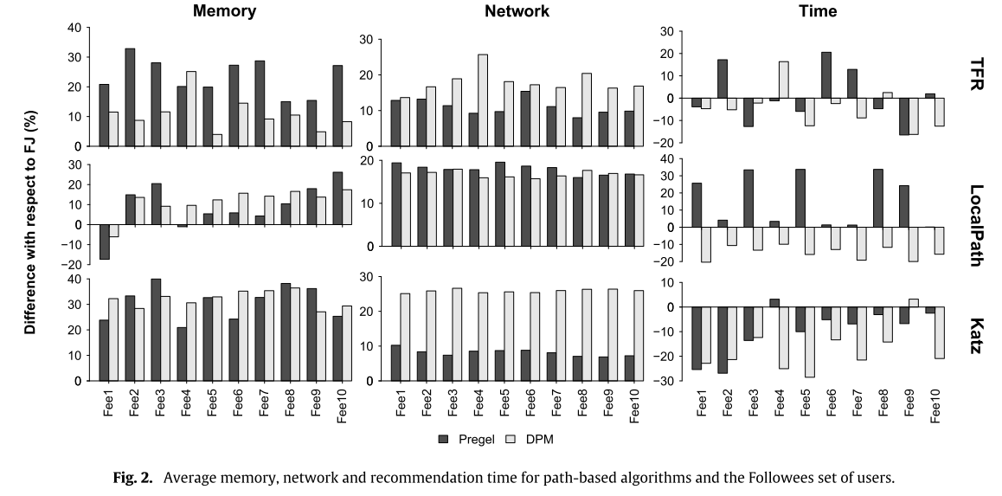
3.Experiments

Slide 9
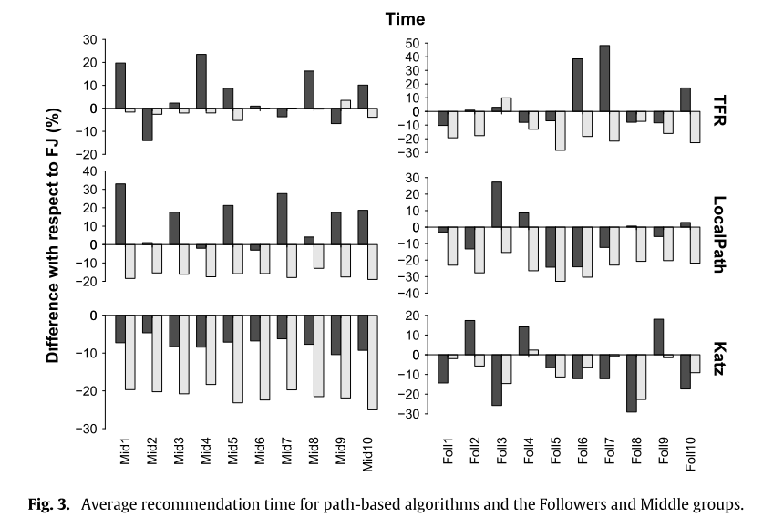
3.Experiments

Slide 10
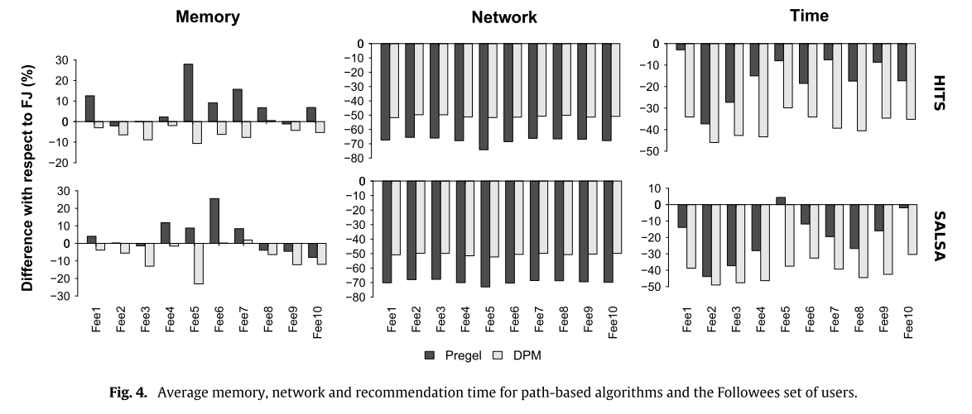
3.Experiments

Slide 11
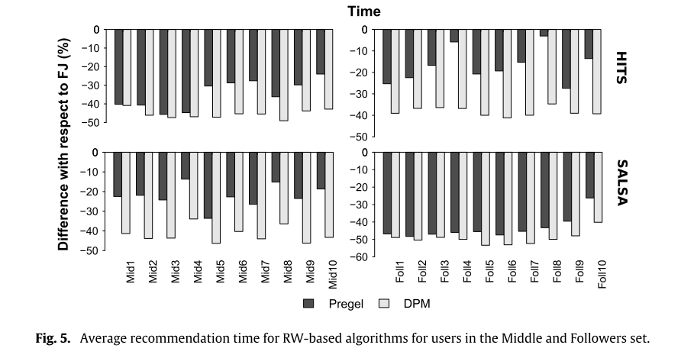
3.Experiments

Slide 12
THANK YOU

